Slide 1
CS 5402 Introduction to Data Mining
4. Data Mining Tools
v.1
Perry B. Koob, koobp@mst.edu

Slide 2
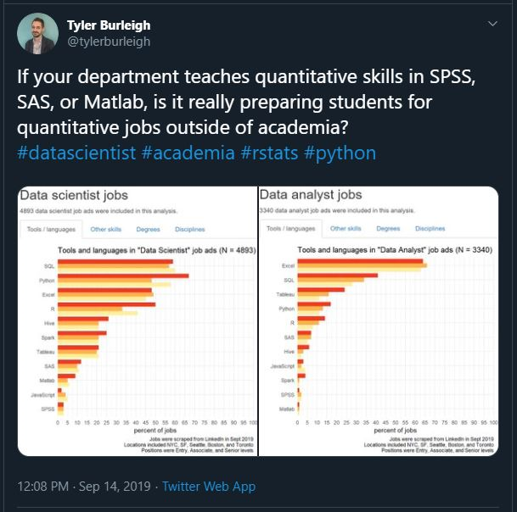

Slide 3
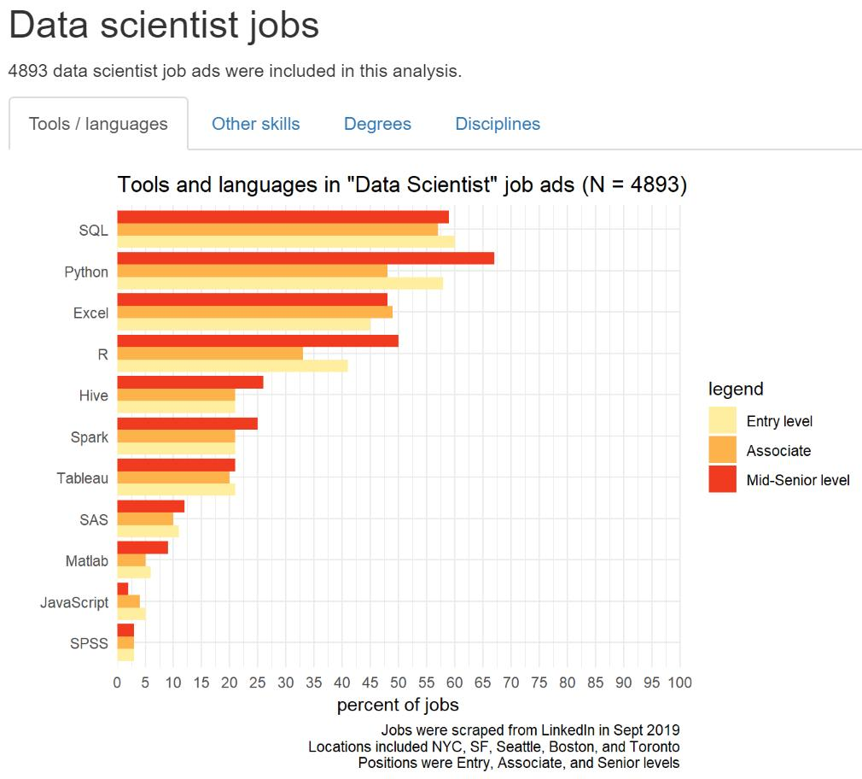

Slide 4
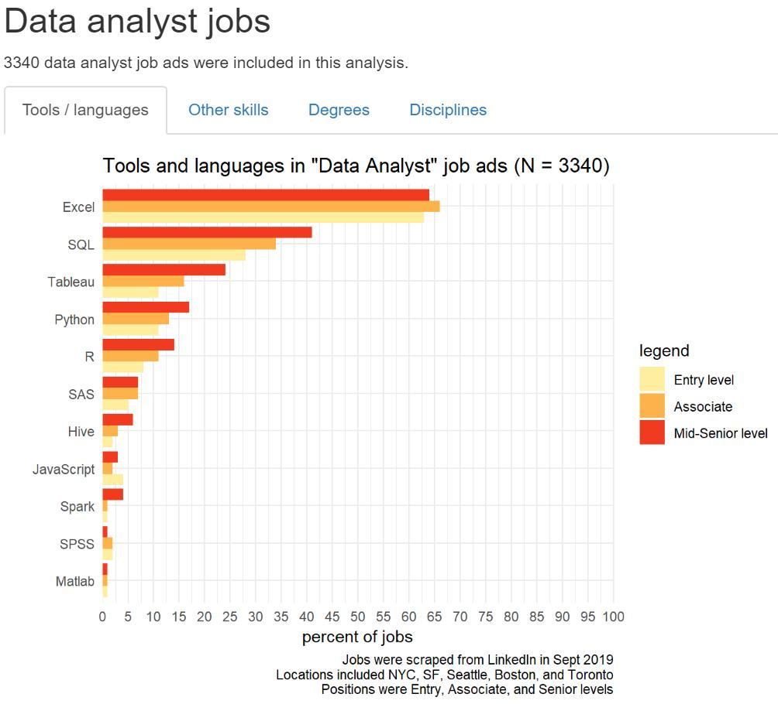

Slide 5
Excel
The tool most people have at least a little bit of experience with, so it is like a common language between a Data Miner, and Data Analysts or anyone in the office.
Most organizations have Excel.

Slide 6
Excel
Good
Tabular data
Filtering by column values.
Simple graphs
Can do low level statistical analysis (with add-on packages).
Concerns
Anything slightly complicated is too much for Excel.
Eats data and munges time date get munged.
Limited size.
Character Encoding

Slide 7
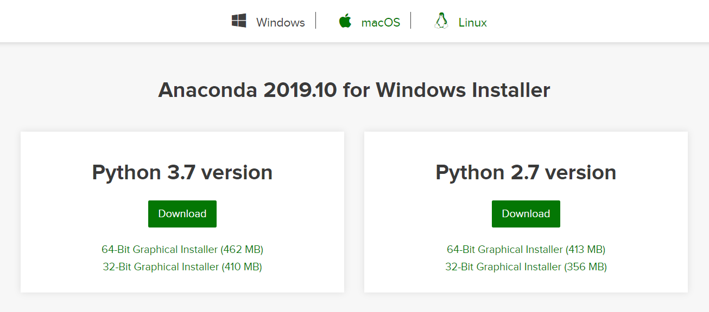
Jupyter Notebooks

Slide 8
Jupyter Notebooks
Full service data mining tool.
Works on Windows, macOS, and Linux
Get Jupyter Notebooks from:
https://www.anaconda.com/distribution/
Getting Started:
https://www.dataquest.io/blog/jupyter-notebook-tutorial/
https://realpython.com/jupyter-notebook-introduction/

Slide 9
Jupyter Notebooks
Good:
Data Analytics
Programming
Handles character encoding seamlessly.
Many packages available.
Active support in stack overflow and may blogs
Can be scripted and run with Python.
Concerns:
Interpreted language, which means it may be slow.
Most of what you do needs to fit in memory, but has ability to handle blocking.

Slide 10
Jupyter Notebooks
Popular Packages:
Numpy
Pandas
Matplot
Scikit Learn
cx_Oracle
Communities:
https://scikit-learn.org/
There are many of them scattered all over, so google with the word Jupyter.

Slide 11
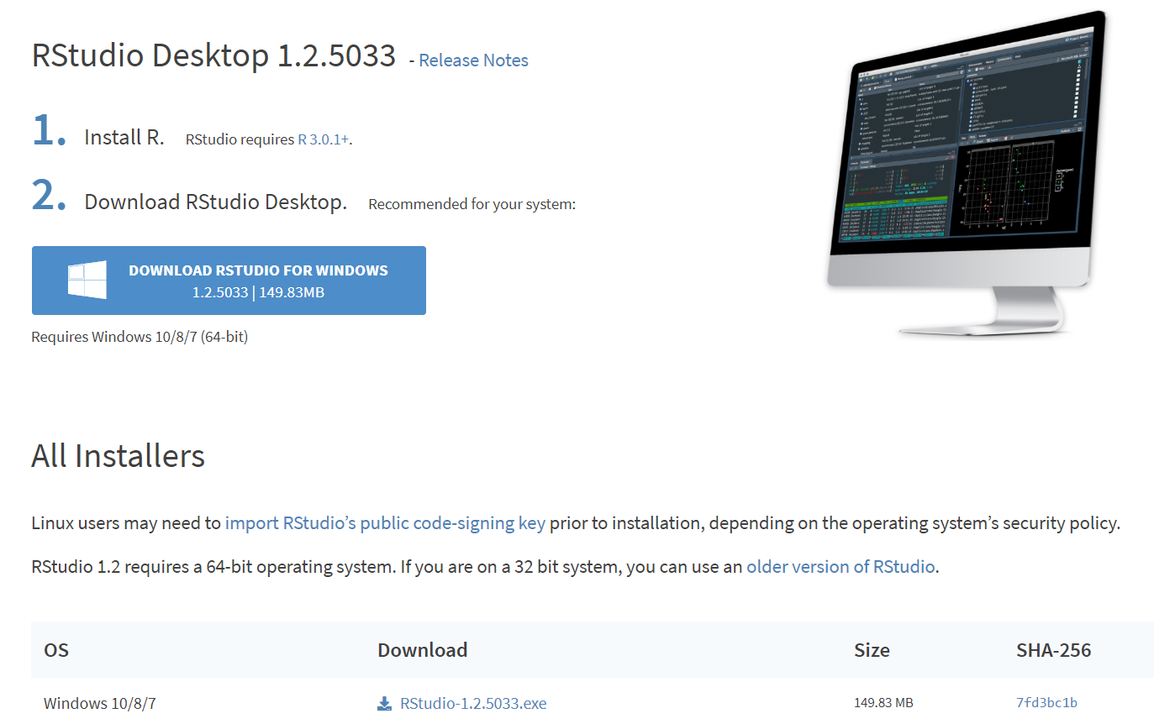
R Studio

Slide 12
R Studio
Full service data mining tool.
Works on Windows, macOS, and Linux
Get R Studio from:
https://rstudio.com/products/rstudio/download/#download
Getting started:
https://ourcodingclub.github.io/2016/11/24/rmarkdown-1.html
https://ourcodingclub.github.io/2016/11/13/intro-to-r.html
https://data-flair.training/blogs/rstudio-tutorial/

Slide 13
R Studio
Good:
Data Analytics
Can easily see memory space.
RData is like a mini database that makes it easy to pick up where you left off.
Very active and helpful community.
Can be scripted and run with R
Concerns:
Slow.
Issues with character encoding in general and between platforms.
Not all packages have been “vetted”.
Your memory space has to fit into memory.

Slide 14
R Studio
Popular packages:
Dplyr
ggplot
Tidyverse
Communities:
https://cran.r-project.org/
https://www.r-bloggers.com/
Twitter @BecomingDataSci @dataandme

Slide 15
Weka
It is a learning platform.
Works on Windows, macOS, and Linux (Java)
Get Weka from:
https://waikato.github.io/weka-wiki/downloading_weka/
Getting started:
https://wekatutorial.com/

Slide 16
Weka
Good:
Good environment for learning.
Concerns:
Highly controlled.
Memory limitations of java applications.
Probably not getting you a job.

Slide 17
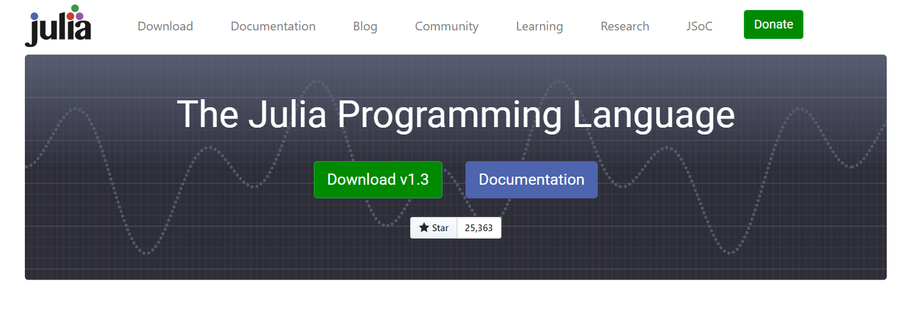
Julia

Slide 18
Julia
Programming language.
Works on Windows, macOS, and Linux
Get Julia from:
https://julialang.org/downloads/
https://datatofish.com/add-julia-to-jupyter/
Getting Started:
https://www.analyticsvidhya.com/blog/2017/10/comprehensive-tutorial-learn-data-science-julia-from-scratch/

Slide 19
Julia
Good:
Competition for Python.
Designed to be faster.
Concerns:
Not very active support community.

Slide 20
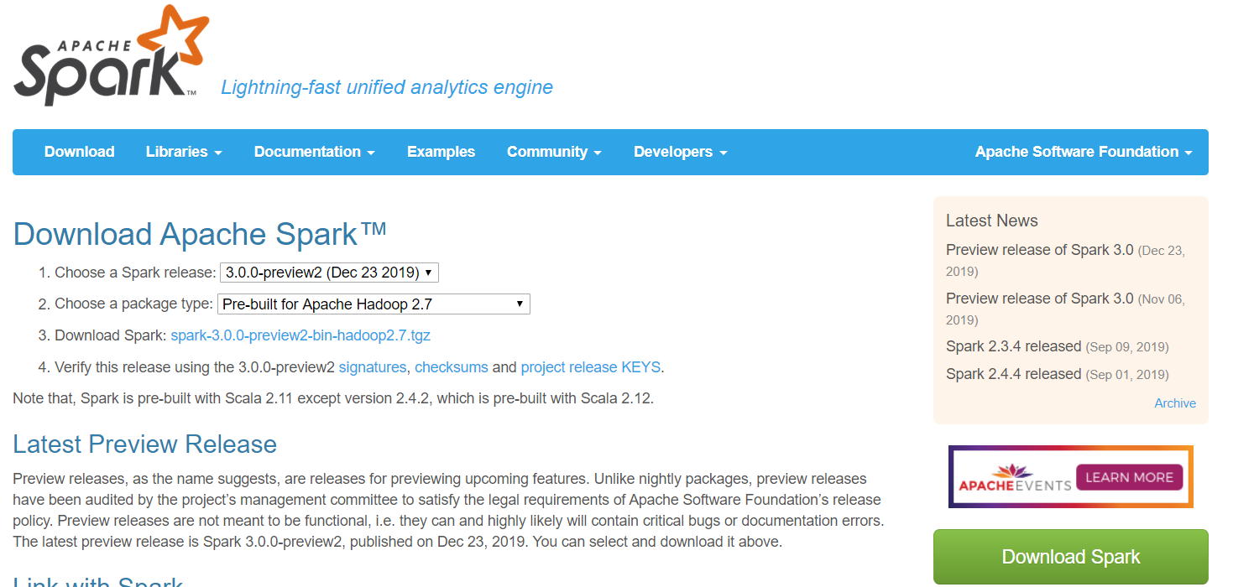
Spark

Slide 21
Spark
Big Data platform. With built in Hadoop and Kubernetes support.
Works on Windows, macOS, and Linux
Get Spark from:
https://spark.apache.org/downloads.html
Getting Started:
https://spark.apache.org/docs/latest/quick-start.html

Slide 22
Spark
Good:
Can use Java, Scala, Python, R, and SQL.
Scales for large data sets.
Idea for Big Data.
Concerns:
Requires an entire environment and multiple servers.
Huge learning curve.
Lots of work required to structure the data and programs.

Slide 23
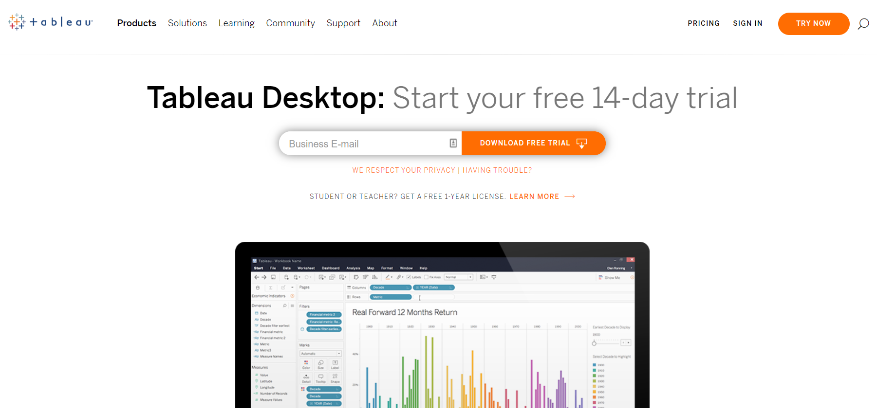
Tableau

Slide 24
Tableau
Visualization and storyboarding tool. It allows you to tell a story with your data.
Works on Windows and macOS
Get Tableau from:
https://www.tableau.com/products/desktop/download

Slide 25
Tableau
Good:
Pretty visualizations and storyboards.
Concerns:
Huge Price tag.
GUI environment.
You will need to do almost all the data preparation in another tool.
Python
Data Warehouse view

Slide 26
References
Witten, I. H., Frank, E., Hall, M. A., & Pal, C. J. (2016). Data Mining: Practical Machine Learning Tools and Techniques.

